Slide 1
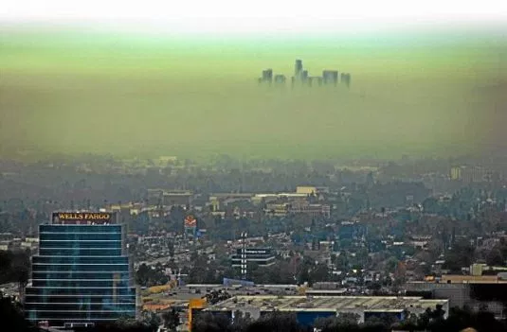
Hypothesis1: Ozone pollutions causes higher asthma rates..
Hypothesis 2: Particulate matter (PM2.5) is responsible for higher asthma rates.
UCSD Data visualization Bootcamp, DATA20180619
Notes:
Tropospheric ozone is a secondary pollutant, it is not emitted directly but instead is produced photochemically in the troposphere by its precursors such as reactive nitrogen oxide (NOx), CO, CH4 and VOC’s. Life time of an ozone molecule in the troposphere varies according to the photochemical activity ( a mean tropospheric life time is ~22days). Ozone has a longer life time in the free and cold troposphere than warmer boundary layer.
difference between stratospheric and tropospheric ozone generation is in the source of atomic O
for solar radiation with a wavelength of less than 242 nm:
O₂ + hv  O + O
photochemical production of O₃ in troposphere tied to NO_{x} (NO + NO₂)
for wavelengths less than 424 nm:
NO₂ + hv  NO + O
but NO will react with O₃
NO + O₃  NO₂
presence of peroxy radicals, from the oxidation of hydrocarbons, disturbs O₃-NO-NO₂ cycle
NO + HO₂·  NO₂ + OH·
NO + RO₂·  NO₂ + RO·
leads to net production of ozone
The ozone molecule has four resonance structure which imparts or confer a slight polarity to the ozone molecule (0.53D).
The bond length 1.272A is intermediate b/w double bond 1.21A and single bond (H-O) 1.47A {angstroms (A)}.
Protective shield in the stratosphere
Strong oxidant
Secondary pollutant in the troposphere
3rd most abundant GHG with RF +0.3 W.m-2
Damage crops and property
Cause respiratory diseases and premature mortality

Slide 2
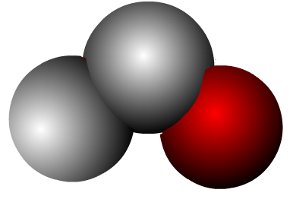
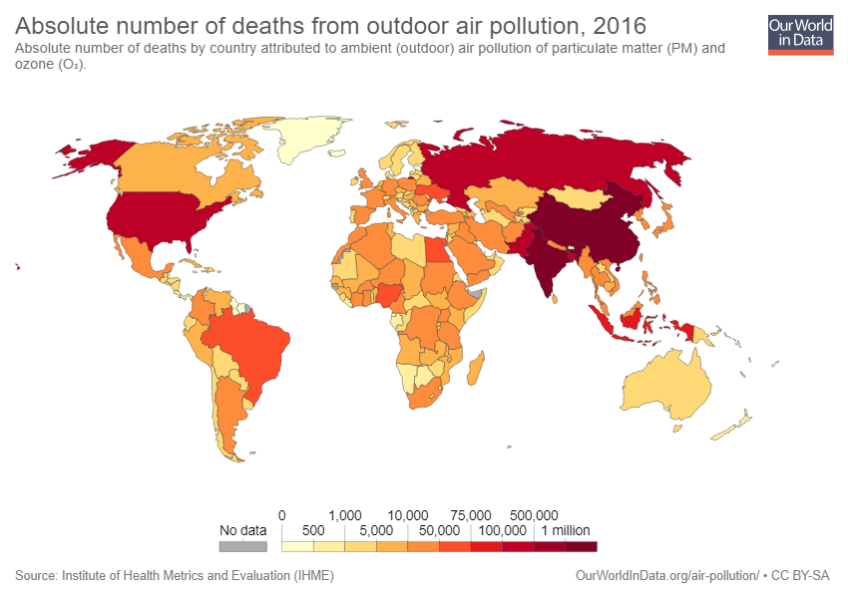
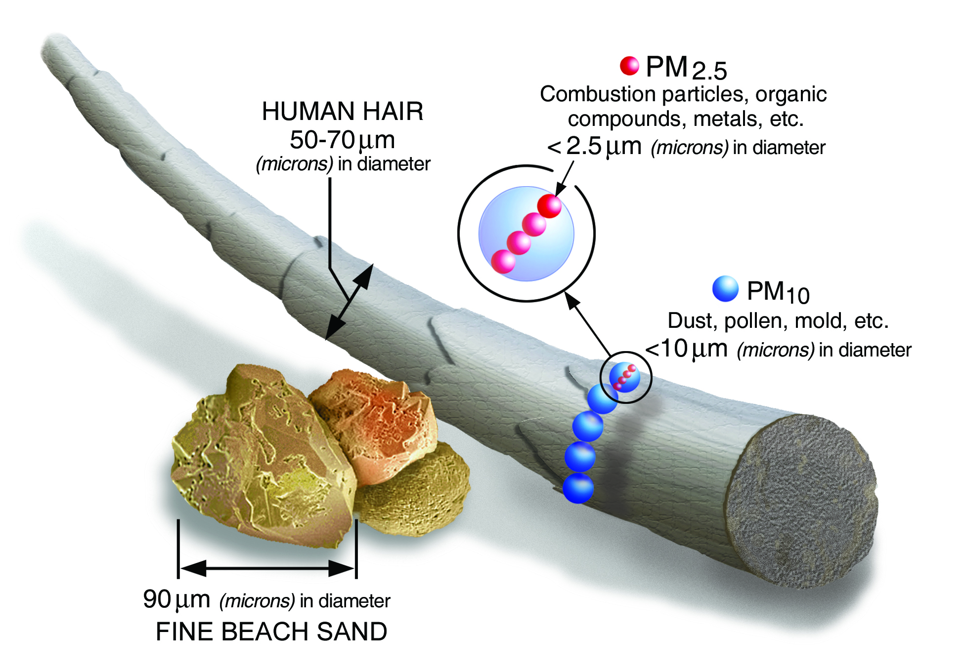
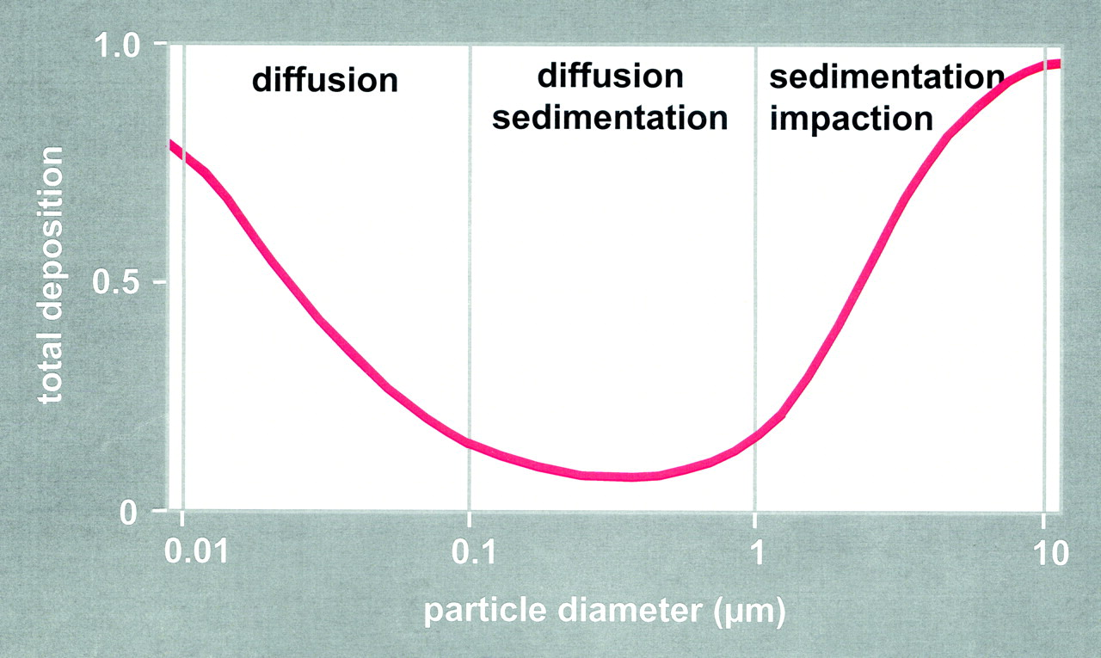
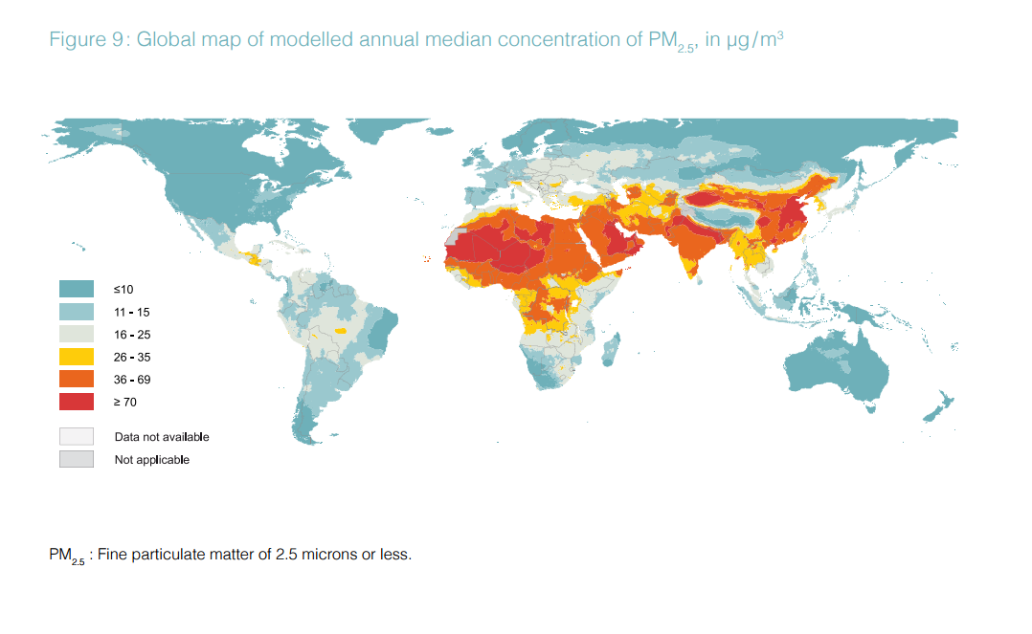
Hypothesis1: Ozone pollutions causes higher asthma rates as people living in polluted areas.
Ozone is a strong oxidant and exist in the gas phase.
Inhaled ozone interact with protein, lipids and can damage at cellular level.
O
Background ozone in clean environment = 20ppb
Polluted environment =40-60ppb.
O
17
O
Hypothesis 2: Particulate matter (PM2.5) is responsible for higher asthma rates.
UCSD Data visualization Bootcamp, DATA20180619
Notes:
Tropospheric ozone is a secondary pollutant, it is not emitted directly but instead is produced photochemically in the troposphere by its precursors such as reactive nitrogen oxide (NOx), CO, CH4 and VOC’s. Life time of an ozone molecule in the troposphere varies according to the photochemical activity ( a mean tropospheric life time is ~22days). Ozone has a longer life time in the free and cold troposphere than warmer boundary layer.
difference between stratospheric and tropospheric ozone generation is in the source of atomic O
for solar radiation with a wavelength of less than 242 nm:
O₂ + hv  O + O
photochemical production of O₃ in troposphere tied to NO_{x} (NO + NO₂)
for wavelengths less than 424 nm:
NO₂ + hv  NO + O
but NO will react with O₃
NO + O₃  NO₂
presence of peroxy radicals, from the oxidation of hydrocarbons, disturbs O₃-NO-NO₂ cycle
NO + HO₂·  NO₂ + OH·
NO + RO₂·  NO₂ + RO·
leads to net production of ozone
The ozone molecule has four resonance structure which imparts or confer a slight polarity to the ozone molecule (0.53D).
The bond length 1.272A is intermediate b/w double bond 1.21A and single bond (H-O) 1.47A {angstroms (A)}.
Protective shield in the stratosphere
Strong oxidant
Secondary pollutant in the troposphere
3rd most abundant GHG with RF +0.3 W.m-2
Damage crops and property
Cause respiratory diseases and premature mortality

Slide 3
Good Ozone in the Stratosphere
Protect from harmful UV radiations.
O + O2 + M → O3 + M
O₃
Bad Ozone in the Troposphere
hν
NO
NO₂
O₃
RO₂
HO₂
Notes:
Tropospheric ozone is a secondary pollutant, it is not emitted directly but instead is produced photochemically in the troposphere by its precursors such as reactive nitrogen oxide (NOx), CO, CH4 and VOC’s. Life time of an ozone molecule in the troposphere varies according to the photochemical activity ( a mean tropospheric life time is ~22days). Ozone has a longer life time in the free and cold troposphere than warmer boundary layer.
difference between stratospheric and tropospheric ozone generation is in the source of atomic O
for solar radiation with a wavelength of less than 242 nm:
O₂ + hv  O + O
photochemical production of O₃ in troposphere tied to NO_{x} (NO + NO₂)
for wavelengths less than 424 nm:
NO₂ + hv  NO + O
but NO will react with O₃
NO + O₃  NO₂
presence of peroxy radicals, from the oxidation of hydrocarbons, disturbs O₃-NO-NO₂ cycle
NO + HO₂·  NO₂ + OH·
NO + RO₂·  NO₂ + RO·
leads to net production of ozone
The ozone molecule has four resonance structure which imparts or confer a slight polarity to the ozone molecule (0.53D).
The bond length 1.272A is intermediate b/w double bond 1.21A and single bond (H-O) 1.47A {angstroms (A)}.
Protective shield in the stratosphere
Strong oxidant
Secondary pollutant in the troposphere
3rd most abundant GHG with RF +0.3 W.m-2
Damage crops and property
Cause respiratory diseases and premature mortality

Slide 4
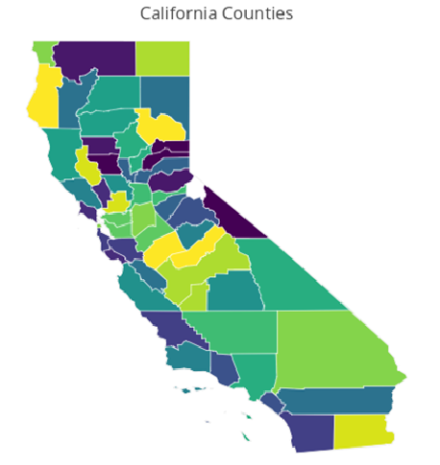
Data Collection Using EPA API
(https://aqs.epa.gov/api)
Nested For Loop
County code
Year
001
003
005
007
…
115
[ DataFrame ]
Parameter of
interest
2011
2012
2013
2014
2015
2016
2017
[ DF1,
DF2,
DF3,
…,
DFi ]
CO2
Ozone
PM2.5
PM10
Wind Speed
Temp
Humidity
[ Master DF ]
~ 3.5 x 10^6 Rows
~ 3 hours of querying
Notes:
Tropospheric ozone is a secondary pollutant, it is not emitted directly but instead is produced photochemically in the troposphere by its precursors such as reactive nitrogen oxide (NOx), CO, CH4 and VOC’s. Life time of an ozone molecule in the troposphere varies according to the photochemical activity ( a mean tropospheric life time is ~22days). Ozone has a longer life time in the free and cold troposphere than warmer boundary layer.
difference between stratospheric and tropospheric ozone generation is in the source of atomic O
for solar radiation with a wavelength of less than 242 nm:
O₂ + hv  O + O
photochemical production of O₃ in troposphere tied to NO_{x} (NO + NO₂)
for wavelengths less than 424 nm:
NO₂ + hv  NO + O
but NO will react with O₃
NO + O₃  NO₂
presence of peroxy radicals, from the oxidation of hydrocarbons, disturbs O₃-NO-NO₂ cycle
NO + HO₂·  NO₂ + OH·
NO + RO₂·  NO₂ + RO·
leads to net production of ozone
The ozone molecule has four resonance structure which imparts or confer a slight polarity to the ozone molecule (0.53D).
The bond length 1.272A is intermediate b/w double bond 1.21A and single bond (H-O) 1.47A {angstroms (A)}.
Protective shield in the stratosphere
Strong oxidant
Secondary pollutant in the troposphere
3rd most abundant GHG with RF +0.3 W.m-2
Damage crops and property
Cause respiratory diseases and premature mortality

Slide 5
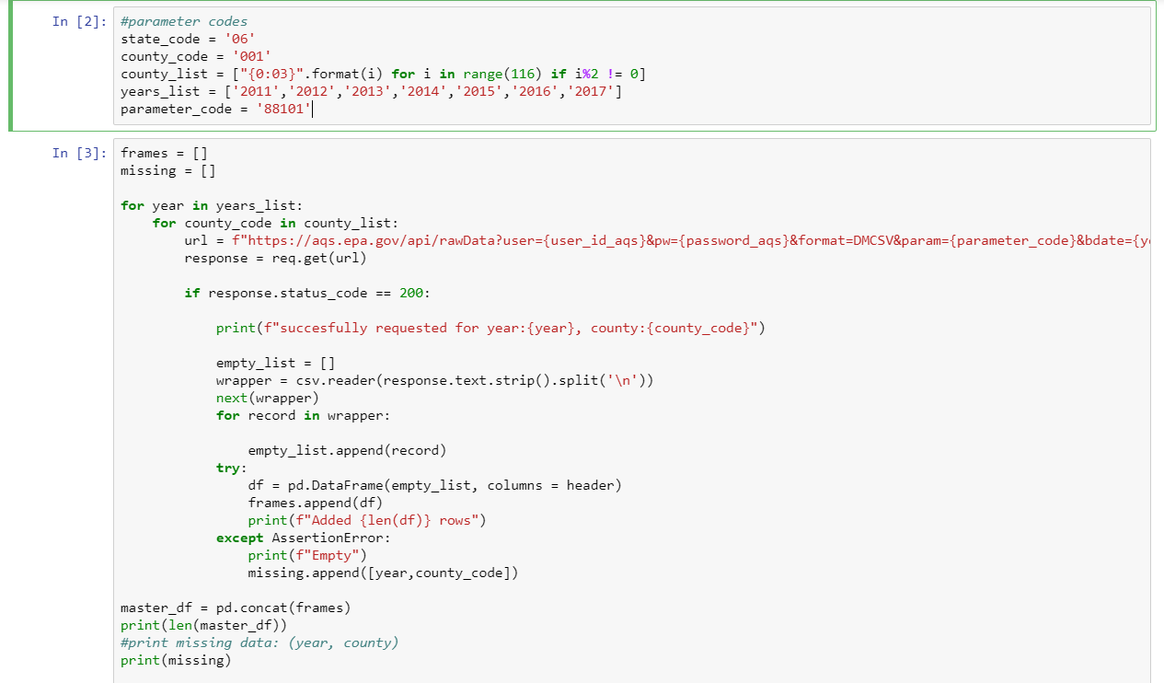
Notes:
Tropospheric ozone is a secondary pollutant, it is not emitted directly but instead is produced photochemically in the troposphere by its precursors such as reactive nitrogen oxide (NOx), CO, CH4 and VOC’s. Life time of an ozone molecule in the troposphere varies according to the photochemical activity ( a mean tropospheric life time is ~22days). Ozone has a longer life time in the free and cold troposphere than warmer boundary layer.
difference between stratospheric and tropospheric ozone generation is in the source of atomic O
for solar radiation with a wavelength of less than 242 nm:
O₂ + hv  O + O
photochemical production of O₃ in troposphere tied to NO_{x} (NO + NO₂)
for wavelengths less than 424 nm:
NO₂ + hv  NO + O
but NO will react with O₃
NO + O₃  NO₂
presence of peroxy radicals, from the oxidation of hydrocarbons, disturbs O₃-NO-NO₂ cycle
NO + HO₂·  NO₂ + OH·
NO + RO₂·  NO₂ + RO·
leads to net production of ozone
The ozone molecule has four resonance structure which imparts or confer a slight polarity to the ozone molecule (0.53D).
The bond length 1.272A is intermediate b/w double bond 1.21A and single bond (H-O) 1.47A {angstroms (A)}.
Protective shield in the stratosphere
Strong oxidant
Secondary pollutant in the troposphere
3rd most abundant GHG with RF +0.3 W.m-2
Damage crops and property
Cause respiratory diseases and premature mortality

Slide 6
UCSD Data visualization Bootcamp, DATA20180619
Notes:
Tropospheric ozone is a secondary pollutant, it is not emitted directly but instead is produced photochemically in the troposphere by its precursors such as reactive nitrogen oxide (NOx), CO, CH4 and VOC’s. Life time of an ozone molecule in the troposphere varies according to the photochemical activity ( a mean tropospheric life time is ~22days). Ozone has a longer life time in the free and cold troposphere than warmer boundary layer.
difference between stratospheric and tropospheric ozone generation is in the source of atomic O
for solar radiation with a wavelength of less than 242 nm:
O₂ + hv  O + O
photochemical production of O₃ in troposphere tied to NO_{x} (NO + NO₂)
for wavelengths less than 424 nm:
NO₂ + hv  NO + O
but NO will react with O₃
NO + O₃  NO₂
presence of peroxy radicals, from the oxidation of hydrocarbons, disturbs O₃-NO-NO₂ cycle
NO + HO₂·  NO₂ + OH·
NO + RO₂·  NO₂ + RO·
leads to net production of ozone
The ozone molecule has four resonance structure which imparts or confer a slight polarity to the ozone molecule (0.53D).
The bond length 1.272A is intermediate b/w double bond 1.21A and single bond (H-O) 1.47A {angstroms (A)}.
Protective shield in the stratosphere
Strong oxidant
Secondary pollutant in the troposphere
3rd most abundant GHG with RF +0.3 W.m-2
Damage crops and property
Cause respiratory diseases and premature mortality

Slide 7
UCSD Data visualization Bootcamp, DATA20180619
Notes:
Tropospheric ozone is a secondary pollutant, it is not emitted directly but instead is produced photochemically in the troposphere by its precursors such as reactive nitrogen oxide (NOx), CO, CH4 and VOC’s. Life time of an ozone molecule in the troposphere varies according to the photochemical activity ( a mean tropospheric life time is ~22days). Ozone has a longer life time in the free and cold troposphere than warmer boundary layer.
difference between stratospheric and tropospheric ozone generation is in the source of atomic O
for solar radiation with a wavelength of less than 242 nm:
O₂ + hv  O + O
photochemical production of O₃ in troposphere tied to NO_{x} (NO + NO₂)
for wavelengths less than 424 nm:
NO₂ + hv  NO + O
but NO will react with O₃
NO + O₃  NO₂
presence of peroxy radicals, from the oxidation of hydrocarbons, disturbs O₃-NO-NO₂ cycle
NO + HO₂·  NO₂ + OH·
NO + RO₂·  NO₂ + RO·
leads to net production of ozone
The ozone molecule has four resonance structure which imparts or confer a slight polarity to the ozone molecule (0.53D).
The bond length 1.272A is intermediate b/w double bond 1.21A and single bond (H-O) 1.47A {angstroms (A)}.
Protective shield in the stratosphere
Strong oxidant
Secondary pollutant in the troposphere
3rd most abundant GHG with RF +0.3 W.m-2
Damage crops and property
Cause respiratory diseases and premature mortality

Slide 8
UCSD Data visualization Bootcamp, DATA20180619
Notes:
Tropospheric ozone is a secondary pollutant, it is not emitted directly but instead is produced photochemically in the troposphere by its precursors such as reactive nitrogen oxide (NOx), CO, CH4 and VOC’s. Life time of an ozone molecule in the troposphere varies according to the photochemical activity ( a mean tropospheric life time is ~22days). Ozone has a longer life time in the free and cold troposphere than warmer boundary layer.
difference between stratospheric and tropospheric ozone generation is in the source of atomic O
for solar radiation with a wavelength of less than 242 nm:
O₂ + hv  O + O
photochemical production of O₃ in troposphere tied to NO_{x} (NO + NO₂)
for wavelengths less than 424 nm:
NO₂ + hv  NO + O
but NO will react with O₃
NO + O₃  NO₂
presence of peroxy radicals, from the oxidation of hydrocarbons, disturbs O₃-NO-NO₂ cycle
NO + HO₂·  NO₂ + OH·
NO + RO₂·  NO₂ + RO·
leads to net production of ozone
The ozone molecule has four resonance structure which imparts or confer a slight polarity to the ozone molecule (0.53D).
The bond length 1.272A is intermediate b/w double bond 1.21A and single bond (H-O) 1.47A {angstroms (A)}.
Protective shield in the stratosphere
Strong oxidant
Secondary pollutant in the troposphere
3rd most abundant GHG with RF +0.3 W.m-2
Damage crops and property
Cause respiratory diseases and premature mortality

Slide 9
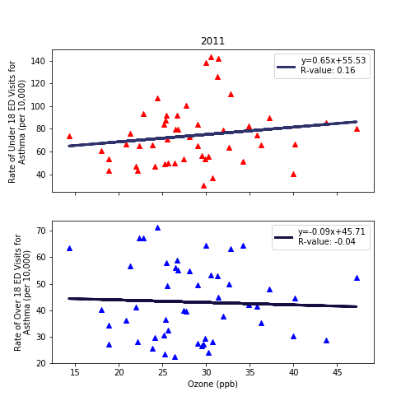
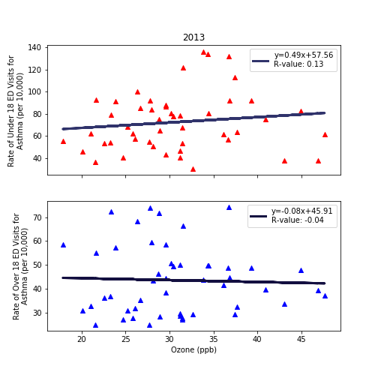
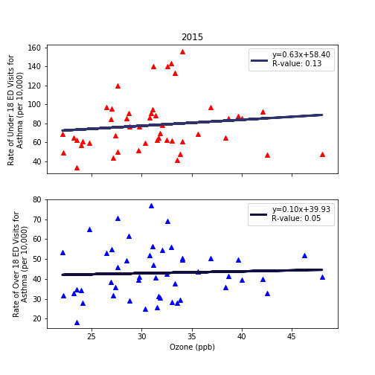
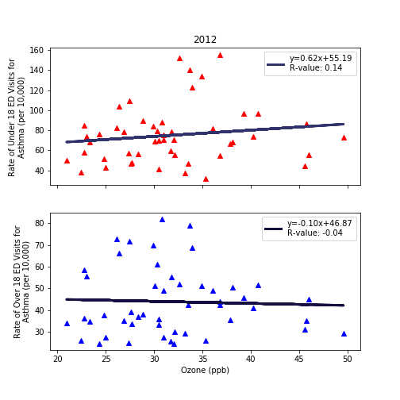
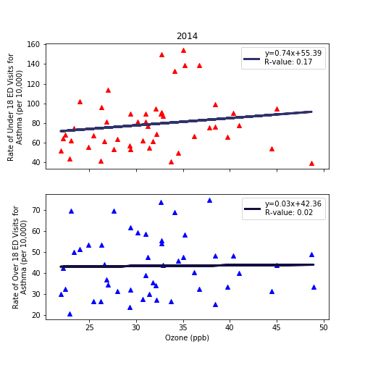
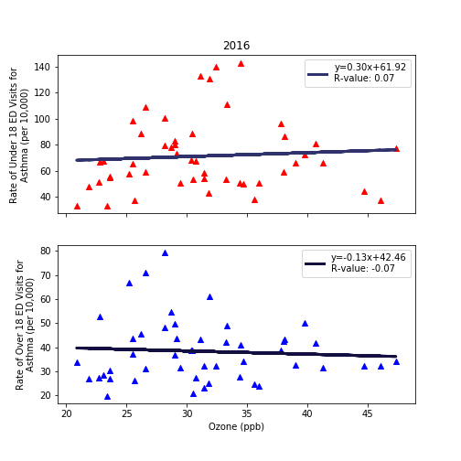
Fig. 1. The ozone concentrations in ambient air across the state of California (2011-2016) and asthma rates per 10,000 individuals admitted during this time. Red triangles: <18yr, blue triangles: >18yr
UCSD Data visualization Bootcamp, DATA20180619
Notes:
Tropospheric ozone is a secondary pollutant, it is not emitted directly but instead is produced photochemically in the troposphere by its precursors such as reactive nitrogen oxide (NOx), CO, CH4 and VOC’s. Life time of an ozone molecule in the troposphere varies according to the photochemical activity ( a mean tropospheric life time is ~22days). Ozone has a longer life time in the free and cold troposphere than warmer boundary layer.
difference between stratospheric and tropospheric ozone generation is in the source of atomic O
for solar radiation with a wavelength of less than 242 nm:
O₂ + hv  O + O
photochemical production of O₃ in troposphere tied to NO_{x} (NO + NO₂)
for wavelengths less than 424 nm:
NO₂ + hv  NO + O
but NO will react with O₃
NO + O₃  NO₂
presence of peroxy radicals, from the oxidation of hydrocarbons, disturbs O₃-NO-NO₂ cycle
NO + HO₂·  NO₂ + OH·
NO + RO₂·  NO₂ + RO·
leads to net production of ozone
The ozone molecule has four resonance structure which imparts or confer a slight polarity to the ozone molecule (0.53D).
The bond length 1.272A is intermediate b/w double bond 1.21A and single bond (H-O) 1.47A {angstroms (A)}.
Protective shield in the stratosphere
Strong oxidant
Secondary pollutant in the troposphere
3rd most abundant GHG with RF +0.3 W.m-2
Damage crops and property
Cause respiratory diseases and premature mortality

Slide 10
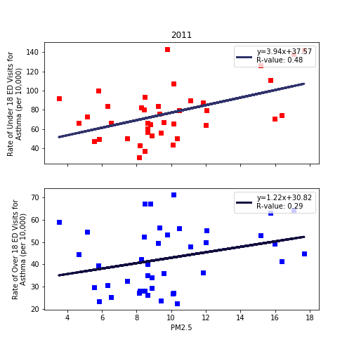
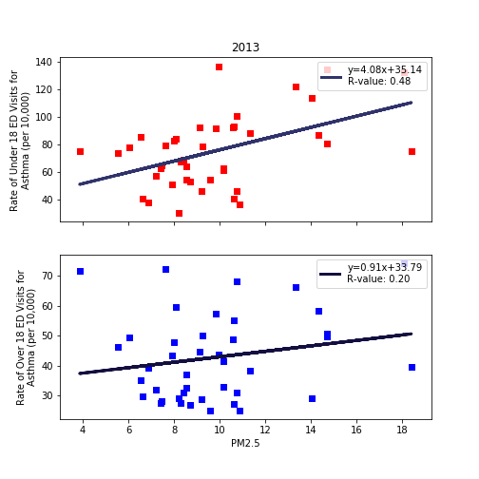
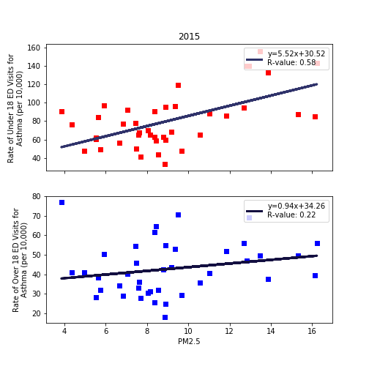
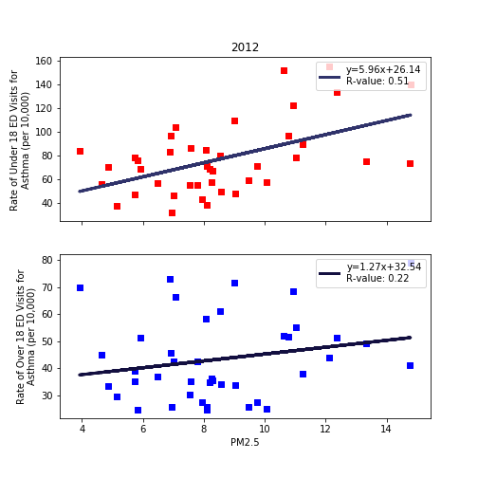
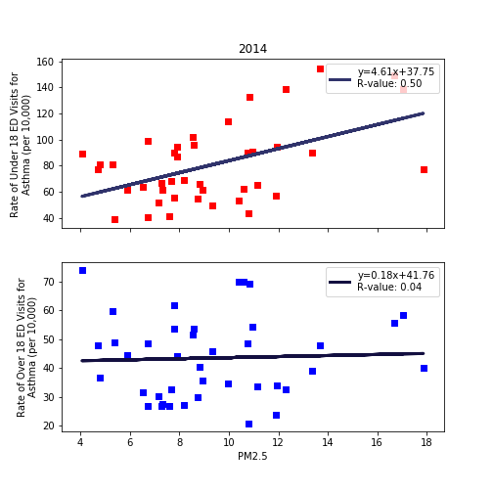
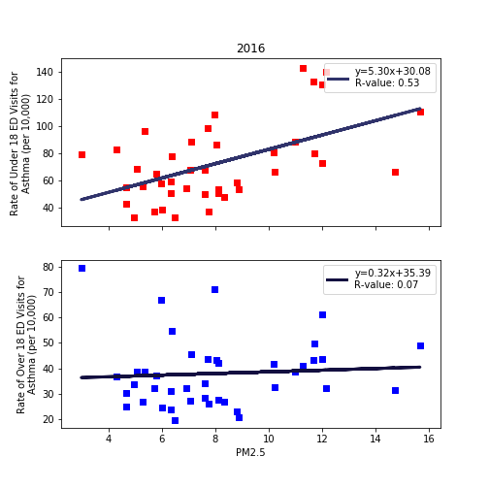
Fig. 1. The PM_{2.5} concentrations in ambient air across the state of California (2011-2016) and asthma rates per 10,000 individuals admitted during this time. Red squares: <18yr, blue squares: >18yr
UCSD Data visualization Bootcamp, DATA20180619
Notes:
Tropospheric ozone is a secondary pollutant, it is not emitted directly but instead is produced photochemically in the troposphere by its precursors such as reactive nitrogen oxide (NOx), CO, CH4 and VOC’s. Life time of an ozone molecule in the troposphere varies according to the photochemical activity ( a mean tropospheric life time is ~22days). Ozone has a longer life time in the free and cold troposphere than warmer boundary layer.
difference between stratospheric and tropospheric ozone generation is in the source of atomic O
for solar radiation with a wavelength of less than 242 nm:
O₂ + hv  O + O
photochemical production of O₃ in troposphere tied to NO_{x} (NO + NO₂)
for wavelengths less than 424 nm:
NO₂ + hv  NO + O
but NO will react with O₃
NO + O₃  NO₂
presence of peroxy radicals, from the oxidation of hydrocarbons, disturbs O₃-NO-NO₂ cycle
NO + HO₂·  NO₂ + OH·
NO + RO₂·  NO₂ + RO·
leads to net production of ozone
The ozone molecule has four resonance structure which imparts or confer a slight polarity to the ozone molecule (0.53D).
The bond length 1.272A is intermediate b/w double bond 1.21A and single bond (H-O) 1.47A {angstroms (A)}.
Protective shield in the stratosphere
Strong oxidant
Secondary pollutant in the troposphere
3rd most abundant GHG with RF +0.3 W.m-2
Damage crops and property
Cause respiratory diseases and premature mortality

Slide 11
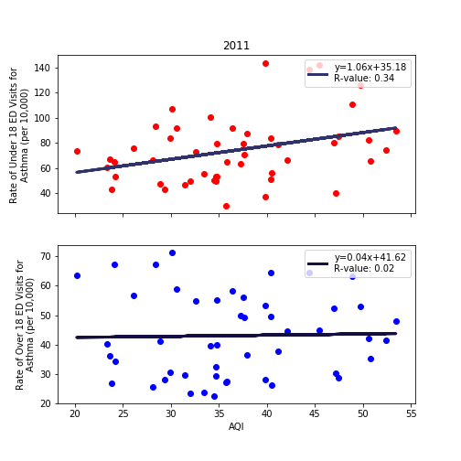
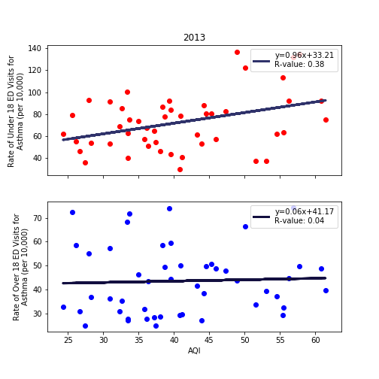
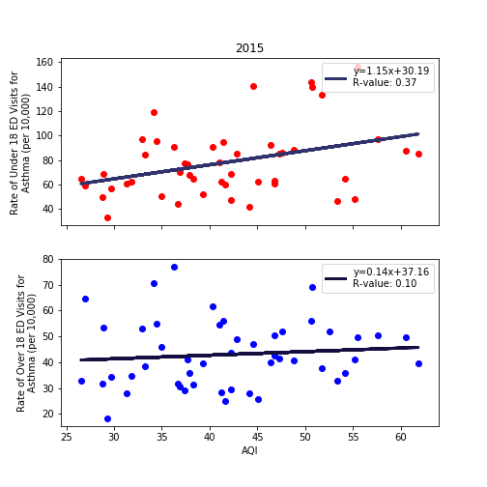
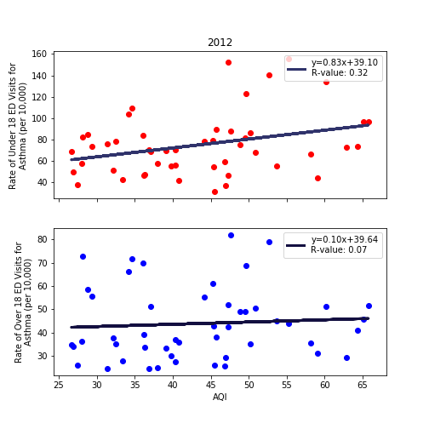
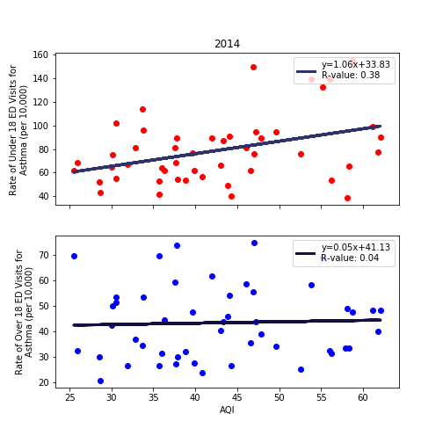
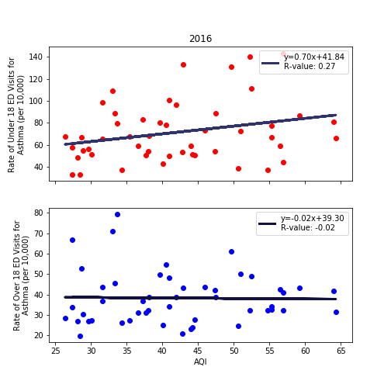
Fig. 1. The Air Quality Index (AQI) across the state of California (2011-2016) and asthma rates per 10,000 individuals admitted during this time. Red squares: <18yr, blue squares: >18yr
UCSD Data visualization Bootcamp, DATA20180619
Notes:
Tropospheric ozone is a secondary pollutant, it is not emitted directly but instead is produced photochemically in the troposphere by its precursors such as reactive nitrogen oxide (NOx), CO, CH4 and VOC’s. Life time of an ozone molecule in the troposphere varies according to the photochemical activity ( a mean tropospheric life time is ~22days). Ozone has a longer life time in the free and cold troposphere than warmer boundary layer.
difference between stratospheric and tropospheric ozone generation is in the source of atomic O
for solar radiation with a wavelength of less than 242 nm:
O₂ + hv  O + O
photochemical production of O₃ in troposphere tied to NO_{x} (NO + NO₂)
for wavelengths less than 424 nm:
NO₂ + hv  NO + O
but NO will react with O₃
NO + O₃  NO₂
presence of peroxy radicals, from the oxidation of hydrocarbons, disturbs O₃-NO-NO₂ cycle
NO + HO₂·  NO₂ + OH·
NO + RO₂·  NO₂ + RO·
leads to net production of ozone
The ozone molecule has four resonance structure which imparts or confer a slight polarity to the ozone molecule (0.53D).
The bond length 1.272A is intermediate b/w double bond 1.21A and single bond (H-O) 1.47A {angstroms (A)}.
Protective shield in the stratosphere
Strong oxidant
Secondary pollutant in the troposphere
3rd most abundant GHG with RF +0.3 W.m-2
Damage crops and property
Cause respiratory diseases and premature mortality

Slide 12
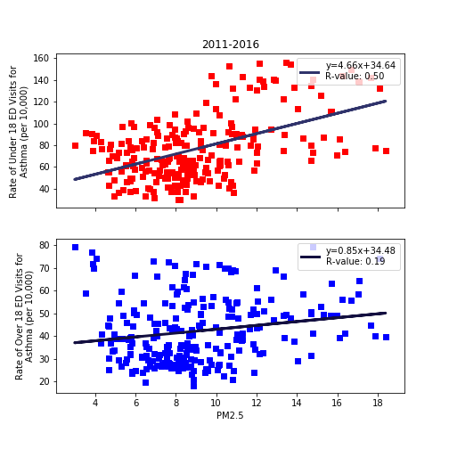
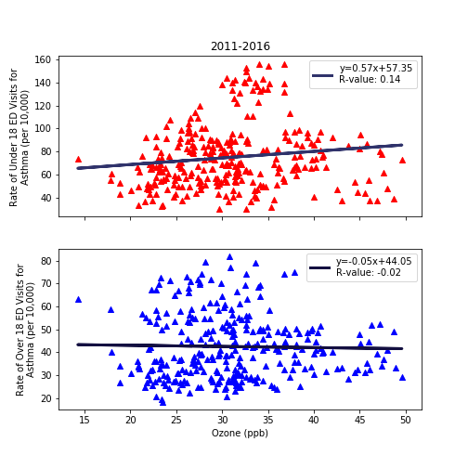
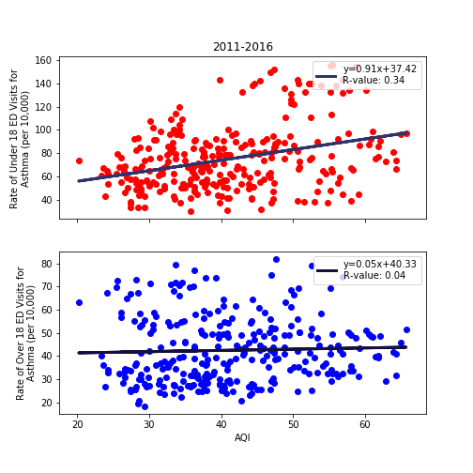
Cumulative data (2011-2016) for all counties

Slide 13
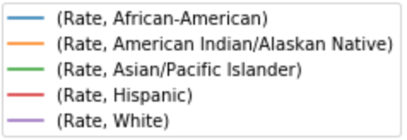
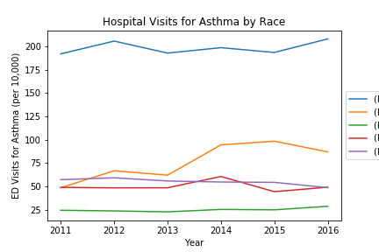
Cumulative data (2011-2016) for all counties and
population demographics
Ambient air PM2.5 and Asthma rate <18 (red squares) and >18 >18yr in the state of California.
Asthma rates sorted on the basis of population demographics from 2011-2016 in the state of California.

Slide 14
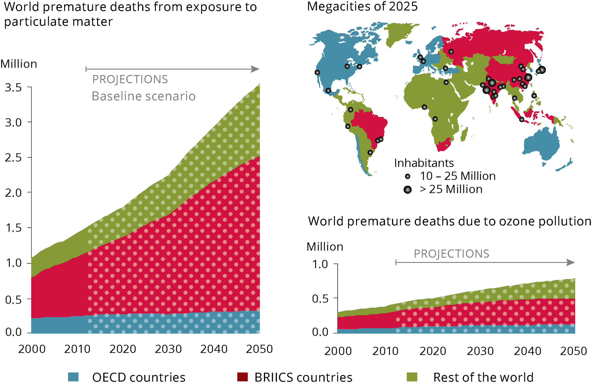
PM2.5 and ozone related pollution and global mortality rates
World health data on mortality rates with air quality and projection to 2025.

